Slide 1
Risk Analysis in Design and Construction of a Hydropower Station
Svana Helen Björnsdóttir, PhD candidate
4th European STAMP Workshop
ZHAW, Zürich, 13.-15. Sept. 2016

Slide 2
introduction

Slide 3
Aim of Research
Seek a generic risk analysis methodology that can be used in different disciplines
Case Study: Hydropower project – one of six
Examine currently used risk analysis methodology
Apply STAMP/STPA to investigate whether it can be used as a basis for a generic risk analysis methodology
Evaluate and compare

Slide 4
Definition of Risk Analysis in ISO 31000 Risk Management Standard

Slide 5
Main Research Question
What is a generic risk analysis methodology that can be applied in different disciplines?

Slide 6
Research Sub-Questions
What is a risk analysis methodology?
What are the commonalities of risk analysis methodologies in different disciplines?
What are the requirements for a generic risk analysis methodology?
Can STAMP/STPA fulfill these requirements?

Slide 7
Iceland National power company landsvirkjun

Slide 8
National Power Company
Owned by the state
Operates 15 power stations in Iceland
Emphasis on operations in harmony with environment and society
One of the largest producers of renewable energy in Europe
Case Study: Latest Hydro Electro Project (HEP) Búðarháls, built in 2010-2014

Slide 9
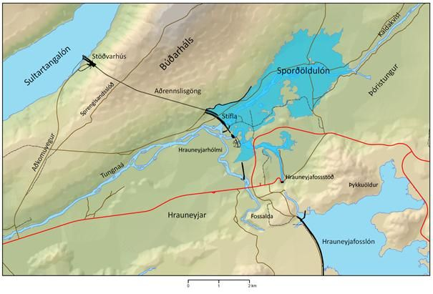
Búðarháls HEP 2010-2014
BúðarhálsHEP©Landsvirkjun

Slide 10
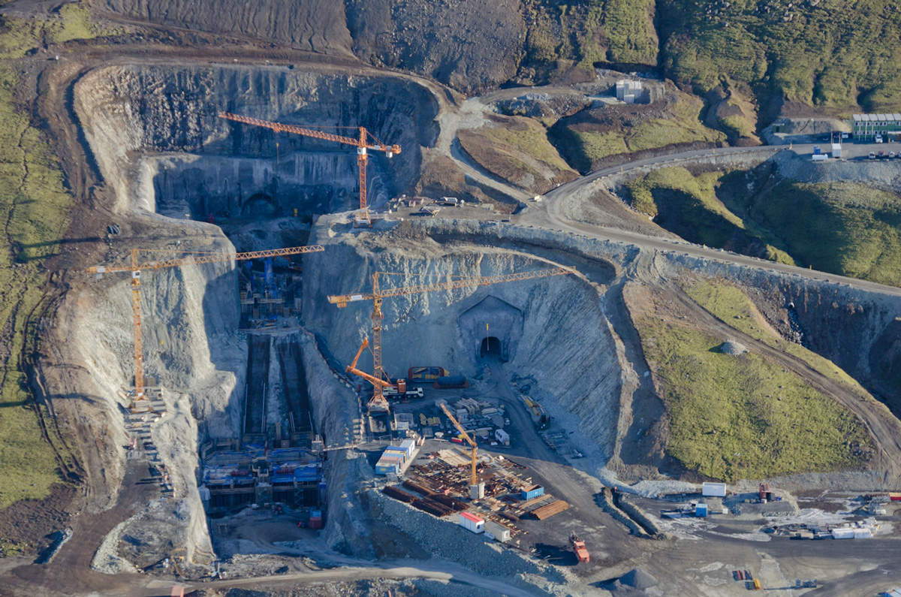
Búðarháls HEP 2010-2014
BúðarhálsHEP©Landsvirkjun

Slide 11
Current Risk Analysis
Company own approach
Written risk assessment procedure
Bottom-up approach
Project driven as a part of project management
Contractors provide own risk information
Risk information gathered & risk register created
Focus on avoiding threats and preventing failure

Slide 12
Research Method

Slide 13
Research Method
Written contract signed by CEO in 2014 – ISO27001 req.
Questionnaire with 49 questions reg. risk issues
Answers received
6 semi-structured follow-up interviews 1-2 hours long
Interview with project risk manger and head of risk mgmt.
According to ISO19011 audit standard
Data collected, documents received
Search for evidence, e.g. processes, procedures, definitions
Documents reviewed
Partly conducted as a master‘s thesis at Reykjavik University in 2015-2016

Slide 14
Application of STAMP/STPA

Slide 15
Why STAMP/STPA?
Current risk methodology does not capture risk in a holistic way
Company policy to seek continuous improvements in risk management
Improve decision making process
To get a different perspective on risk than currently exists
Systems approach to risk identification and risk analysis is needed

Slide 16
Project Goals in the HEP
Project goal is to complete and deliver a hydropower station:
In time for planned operation and energy sales
In compliance with law, regulations, contracts and standards
Without exceeding the approved budget plan
For safe operation and delivery of sufficient power

Slide 17
Accidents/Unacceptable Losses
A1: Loss of human lives
A1: Financial loss (overrun of budget or project delay)
A3: Unsafe usage of equipment and other resources
A4: Power plant does not deliver sufficient power
A5: Breach of laws, regulations, contracts, standards
A6: Loss of public policy support
A7: Loss of safety/security/quality when outsourcing

Slide 18
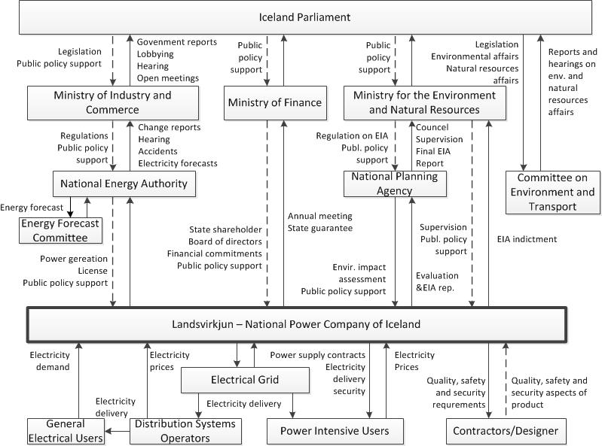
HCS for Landsvirkjun
Dotted lines indicate flaws in HCS

Slide 19
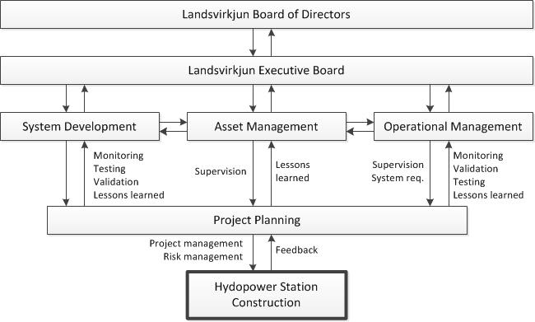
HCS for Landsvirkjun

Slide 20
Main Hazards and Threats
Three main hazards and threats:
H1: Project not finished in time for operation to start
H2: Injury or loss of human lives
H3: Overrun of budget plan

Slide 21
System-Level Safety Constraints
Management team must establish a control structure to manage project and project risk
People working on construction site must not be injured
Measure must be taken to reduce likelihood of accidents on construction site
Means must be available and effective to treat risk on site
Project risk manager must review and monitor risk in project plans
Operational Management must be involved early enough to supervise and validate system requirements

Slide 22
Control Actions
Two cases of Control Actions investigated:
Involvement of operation in design and development of HEP
Involvement of risk manager (or risk management team) in HEP – investigated by a master’s student at Reykjavik University, see workshop poster

Slide 23
Example 1 of UCA
Control Action: Involvement of operation in design and development of HEP
Not Providing Causes Hazard | Providing Causes Hazard | Wrong Timing or Order Causes Hazard | Stopped Too Soon or Applied Too Long
Operation is not involved, thus not providing necessary input and information (H1,H2,H3). | If operation is involved but recommendations are incorrect, this can cause hazard (H1,H2,H3). | Early involvement provides no hazard. Late involvement can cause hazard (H1,H2,H3). | If operation involvement stops too soon, this can cause hazard (H1,H2,H3). Too long: No hazard.
Operation is not involved, thus not providing necessary input and information (H1,H2,H3). | If operation is involved but recommendations are ignored, this can cause hazard (H1,H2,H3). | Early involvement provides no hazard. Late involvement can cause hazard (H1,H2,H3). | If operation involvement stops too soon, this can cause hazard (H1,H2,H3). Too long: No hazard.

Slide 24
Example 2 of UCA
Control Action: Involvement of risk manager (or risk management team) in HEP
Not Providing Causes Hazard | Providing Causes Hazard | Wrong Timing or Order Causes Hazard | Stopped Too Soon or Applied Too Long
If risk manager is not involved in design and development of project, this may cause hazards (H1,H2,H3). | If risk manager is involved but his work is ineffective (incorrect or insufficient), this may cause hazard (H1,H2,H3). | Early involvement causes no hazards. Late involvement may case hazards (H1,H2,H3). | If stopped to soon may cause hazard (H1,H2,H3). Applied too long causes no hazard.
If risk manager is not involved in construction phase on site, this can cause hazard (H1,H2,H3). | If risk manager is involved but his work is ineffective (incorrect or insufficient) this may cause hazard (H1,H2,H3). | Early involvement causes no hazards. Late involvement may case hazards (H1,H2,H3). | If stopped to soon may cause hazard (H1,H2,H3). Applied too long causes no hazard

Slide 25
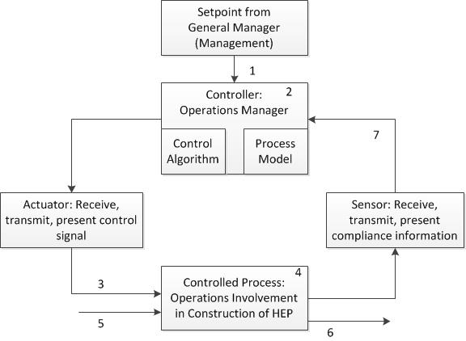
Identifying Causal Scenarios in Ex.1

Slide 26
Examples of Potential Causes of UCA
No. | Potential Causes of Hazards and Threats to a HEP Project
1a | Management Team does not allocate enough resources from Operation
1b | The involvement of Operation is incorrectly scheduled by Head of Operation
2a | Incorrect understanding of project scope, project plans and procedures
2b | Estimation of Operations man-hours is incorrect, more resources is required in the project
2c | Required competence of Operations staff in the project is underestimated or incorrect
3 | Operations staff get their instructions too late when alignment with contractors need to start
4a | Operations staff is not available when required start of working with contractors
4b | Operations staff is replaced during initial development of project, loss of know-how and experience
5 | Lack of resources by Operations, Head of Operation requires support of staff members in another project at the same time
6a | Incorrect information is given to contractors
6b | Correct information provided to contractor is not considered
7a | Operation report start of alignment with contractor although it has effectively not yet started
7b | Operation report start of alignment with contractor too late

Slide 27
Findings and Evaluation

Slide 28
Findings and Evaluation
Búðarháls HEP was a successful project
Time and budget plans were met
No major accident, however near-to losses
Risk management processes were followed
Comparison of two risk registers:
Risk register from 2011 has 149 risks
Risk register from 2013-2014 has 154 risks
Risk management strategy in Búðarháls HEP:
Define goals
Risk matrix approach with contribution from contractors

Slide 29
Findings and Evaluation
STAMP/STPA takes a different approach:
Create HCS and define roles and responsibilities
Define unacceptable losses
STAMP/STPA framework is a more structured approach
Clear methodology and process for analyzing risk
Traceability ensured
Justification and rationale are available
Identification of causes of unsafe or inadequate Control Actions
CAs and causes of UCA or ICAs in the case study are credible

Slide 30
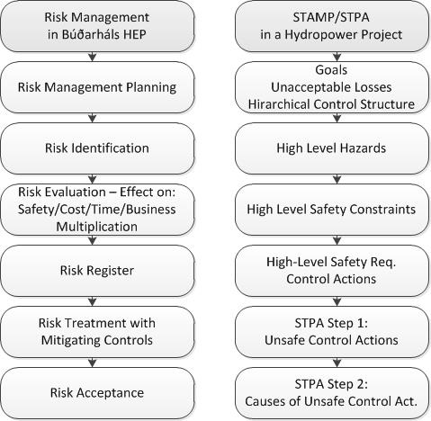
Findings and Evaluation

Slide 31
Findings and Evaluation
With STPA more detailed and precise risk mitigation strategies can be developed
The bottom-up risk approach in Búðarháls HEP proves to be practical in many ways – contractors are able to understand, share and participate
Two types of project risk investigated
High level project risk
Risk in the risk management process itself
STPA can be used independently by an analyst with knowledge of techniques and project context

Slide 32
Findings and Evaluation
Not all risks in a hydropower project can be identified with project based bottom-up risk analysis methodology
With STPA we get another perspective that helps us identify previously unidentified risks
Flaws in the control structure were identified with STPA – but not by current method

Slide 33
Findings and Evaluation
Request for combined use of STPA and bottom-up risk analysis
ISO standards require well defined risk analysis methodology – but don’t tell how
In long term STAMP/STPA will influence:
Development of ISO risk management standards
Project management standards, e.g. requirements and checklists
Contracts, compliance requirements

Slide 34
Conclusions

Slide 35
Conclusions
No generic risk analysis methodology has yet been defined as such, but STAMP/STPA has been applied in many different disciplines
Risk terms not yet properly defined as science requires – depends on industry sector and research field
Risk based thinking now required in ISO9001 quality management standard
Risk analysis methodologies need to be defined for scientific use

Slide 36
Conclusions
There are commonalities of risk analysis requirements in different industries, e.g. when using ISO31000
The requirements for a generic risk analysis methodology must be investigated further
No limitation found to the applicability of STAMP/STPA other than it requires training, understanding – and preferably a software tool to support use

Slide 37
BúðarhálsHEP©Landsvirkjun

Slide 38
Thanks to ...
Landsvirkjun
Páll Jensson
Robert Jan de Boer
Katrín Dögg Sigurðardóttir
Lorene Pelegrín

Slide 39
Questions and further information?
Svana Helen Björnsdóttir
svana@stiki.eu

