Slide 1


Safety and Security Analysis in Automated Urban Guided Transport Systems using STPA
Fei Yan
Beijing Jiaotong University

Slide 2
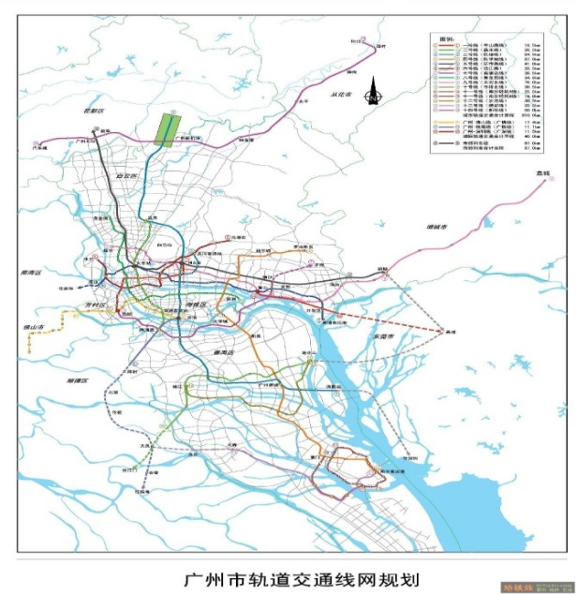
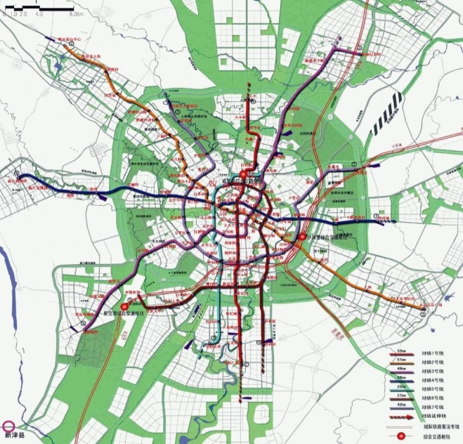
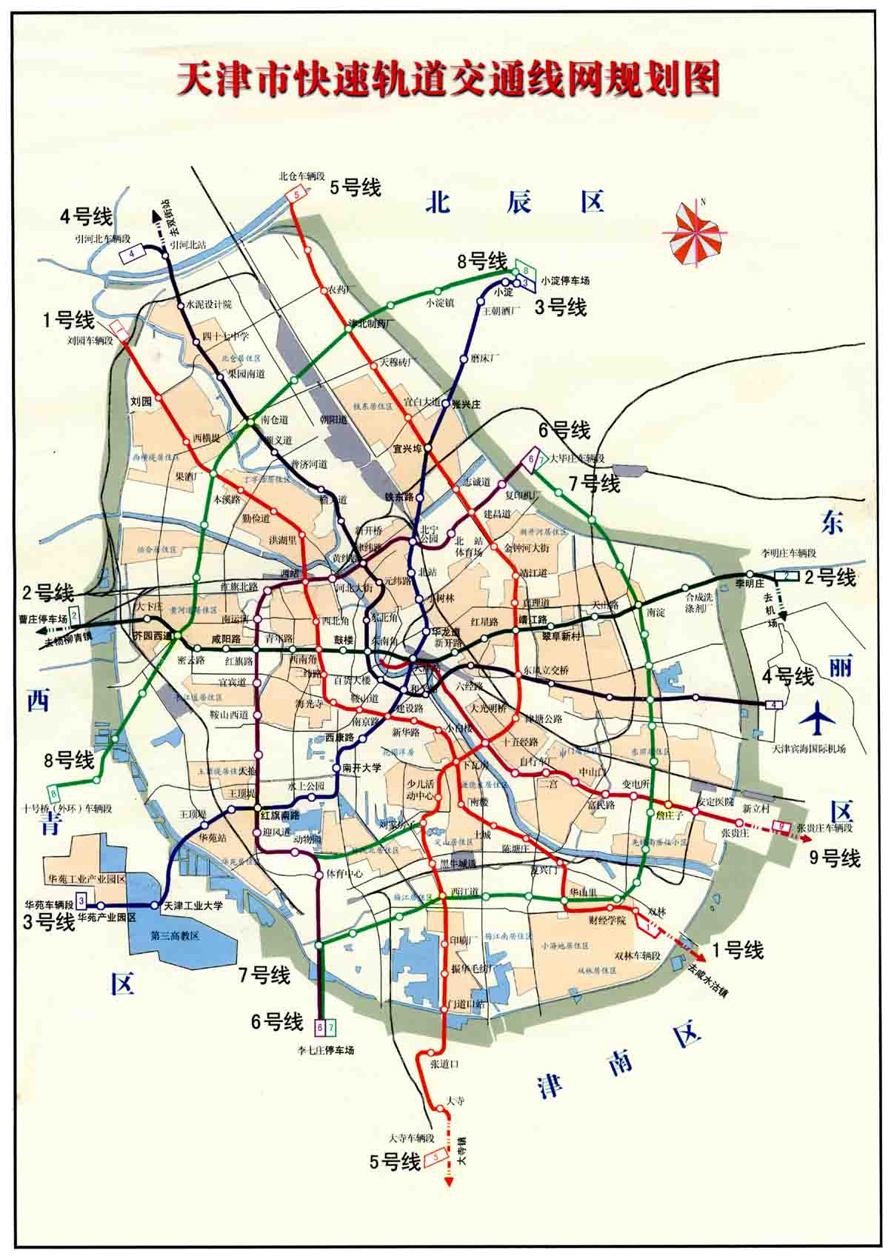
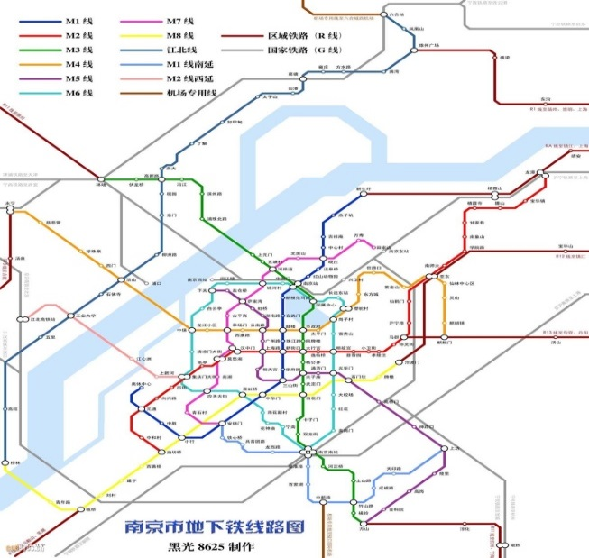
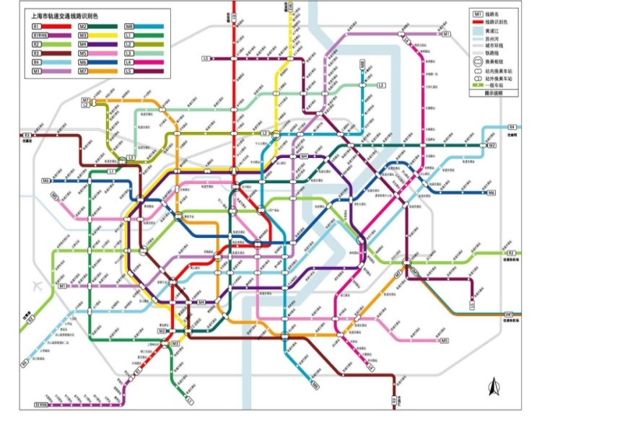
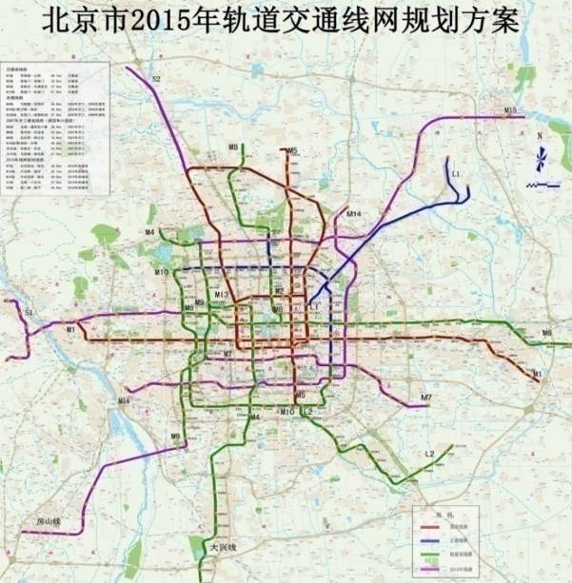
Urban Transit Development In China
3600 KM urban transit lines are operating now in more than 20 cities.
Before 2020, another 3000 KM lines will be built.
Beijing
Shanghai
Tianjin
Guangzhou
Nanjing
Chengdu

Slide 3
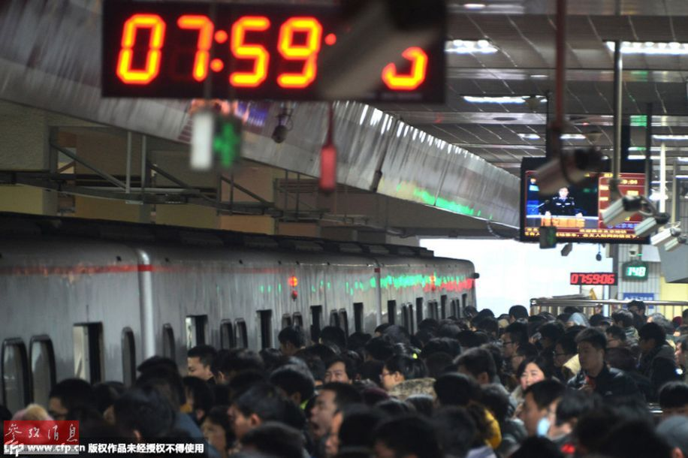
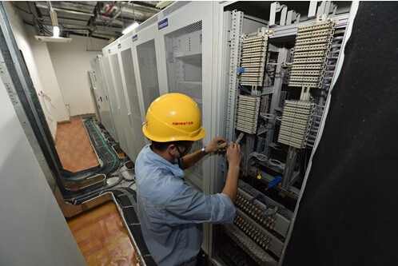
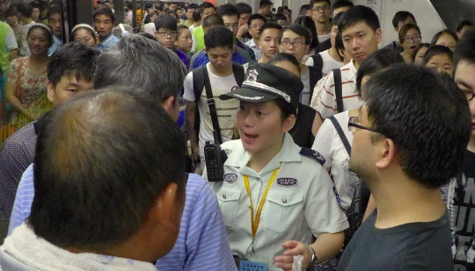
  Background – Beijing Metro
  Safety Critical Operational System
  Complex Socio-tech System
  High Transportation Demand

Slide 4
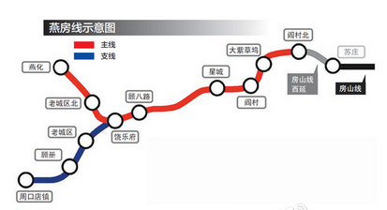
Automated urban guided transport (AUGT)
Beijing Metro plans to open Yanfang Line at the end of 2017. It is an Automated Urban Guided Transport (AUGT) Line. And in the next 5 years, Beijing will open another 5 AUGT Lines.
The main difference between the AUGT line and existing line is no driver or attended people on the train.

Slide 5
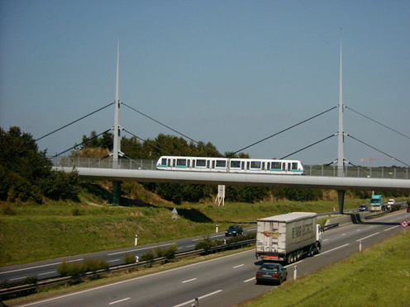
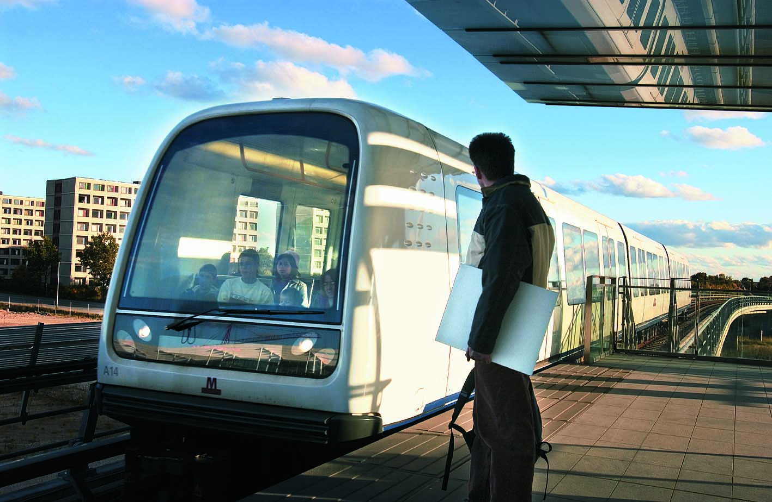
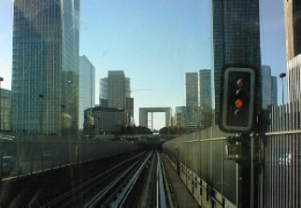
Historical overview of AUGT system
60s :
- development of ATO, prototypes
70s :
- implementation of ATOs
- Small-sized UTO systems
80s
- fully UTO « metros »-Lilli Metro Line 1
90s
- deployment of « proven » UTO metros of higher capacity
2000s
- continuity : Rennes, Copenhagen, Torino
- upgrading of conventional lines into UTO
2010s
- AUGT system has been applied for mass transit system, like Paris Line 1 , Shanghai Line 10, etc.

Slide 6
Grades of automation ( IEC62267/62290 )
Grade of Automation
Type of train operation
Setting train in motion
Stopping train
Door closure
Operation in event of Disruption
GoA 1
ATP
with driver
Driver
Driver
Driver
Driver
GoA 2
ATP and ATO with driver
Automatic
Automatic
Driver
Driver

Train attendant
Train attendant
GoA 3
Driverless
Automatic
Automatic
GoA 4
Driverless,
unattended
Automatic
Automatic
Automatic
Automatic

Slide 7
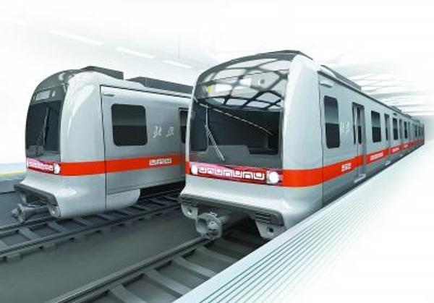
Features of AUGT：Automated urban guided transport
AUGT is a system which：
Transport passengers between stations
Uses automated self-propelled trains
Runs on an exclusive guide way
Allows train operation independent from other traffic
Provides conditions of safe train movement

Slide 8
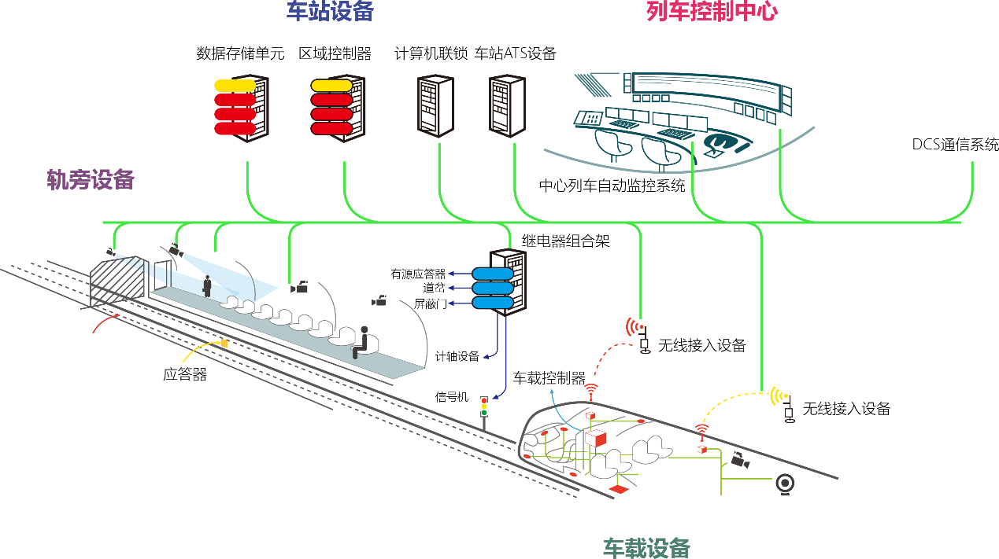
The structure of AUGT
Station based Equipment
Control Center
Station, Train, Guide way between stations, depots, Control center
Entities to be protected：Persons, Passengers, Staff, Public, Property
Wayside
Equipment
Data Communication System
Balise
Onboard Equipment

Slide 9
Safety Function of AUGT
Supervising guideway
  Prevent collision with obstacle
  Prevent collision with persons
Supervising passenger transfer
  Control passenger doors
  Prevent injuries to person between cars or between platform and train
  Ensure safety starting conditions
Operating a train
  Put in or take out of operation
  Supervise the status of the train (UTO)
Ensuring detection and management of emergency situations

Slide 10
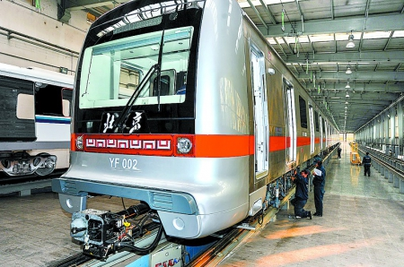
Beijing Yanfang Line - Normal Operation Scenario Aspect
On the morning power up
wake
Outbound
rolling road car operations
enter into a mainline station
stopping
departure platform
reentrant changing end
Evacuate passengers
stop mainline service
Return to depot
Sleeping
cleaning
automatic washing
shunting

Slide 11
Beijing Yanfang Line - Emergency Scenarios
Fault reset control
shut the door control
emergency braking and alleviating
vehicle fire
FAM/CAM mode conversion
motility patterns
working state of the equipment remote monitoring
door fault isolation platform
platform door fault isolation
door status loss
rain and snow patterns
vehicle braking system breakdown
rescue
daily inspection and maintenance
train remote radio
station fire barrier
detection of derailment
door state loss
Keep train/jump stop
signal or failure of the vehicle after processing platform

Slide 12
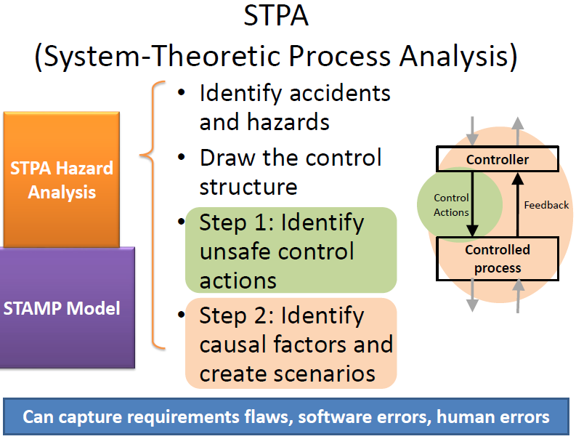
STPA
A Systematic Method

Slide 13
HAZOP Practice in CBTC Project
In the project of CBTC, after finishing the HAZOP Analysis for each Scenario, there are lots of hazards which have been identified. Combination and Screening work need to be done. One third of the total hazards could be kept. And the traceability is a big problem.
But for AUGT or FAO project, we found that people’s operation has been combined into the whole system operation. When we used HAZOP method, it is hard to combine the hazard in different scenario.

Slide 14
STPA Expectation
STPA is a method which can focus on the high level hazard and related constraint analysis. Control system Concept can combined the people’s operation, management and the operation of equipments. So it is more efficiency than HAZOP method.
Hazards and causal factors have tight relationship with operational scenario. If we divided the scenario more detail, we can found more detail casual factors. And we can easily find the proper safety requirements.

Slide 15
AUGT Systematic Accidents and Hazards
A1. Train and train collision
A2. Trains collide with obstacles within the track clearance (including passengers or operations staff)
A3. Train derailment
A4. Passenger injuries related to doors
H1. Train speeding [A1, A2, A3]
H2. Abnormal opening or closing the door [A4]

Slide 16
System Control Structure

Slide 17
Control Process Model

Slide 18
Unsafe Control Actions
Hazard | Control Action | Not Providing Caused Hazard | Providing Causes Hazard | Wrong Timing/Order Causes Hazard | Stopped Too Soon or Applied Too Long
H1. Train speed control | TIAS Remote brake（Train braking） | Uca1：When there is an obstacle in the station track gauge, not make the train parking outside the station | / | / | /

Slide 19
Scenario based process model for UCA1
When there is an obstacle in the station track gauge, not make the train parking outside the station

Slide 20
Causal Factor for UCA1
When there is an obstacle in the station track gauge, not make the train parking outside the station

Slide 21
Hazard List and Hazard Log of Uca1
Hazard | Unsafety control action | Causal factor number | Causal factor | Safety constraint number | Safety constraint/requirement/mitigation | comment
H1. Over speed when the train pulled into station | Uca1: When there are obstructions in the station track clearance，TIAS center dispatcher don’t via remote command to make the train stop outside the station. | H1-Uca1-CF1 | Not found obstructions within the station track clearance | H1-Uca1-SC1 | Developed for track clearance inspection requirements, including inspection time check period and inspection processes, etc.
 |  |  |  | H1-Uca1-SC2 | Design and installation of wayside obstacle detection devices, such as additional CCTV platform to the station and close to the range of track gauge to monitor
 |  |  |  | H1-Uca1-SC3 | Design and installation of automotive obstacle detection device: when the device come into contact with an obstacle, it can detect the obstacle in front of the train, if the obstacle is detected, the train should implement the emergency brake.

Slide 22
Methodology Comparison
Comparison | STPA | HAZOP
Advantages | System view and focusing on the interaction and the safety constraints between components of system | Focusing on the information flow and good at the analysis of operational scenario
Disadvantages | Detail Design analysis which can be enhanced by scenario based STPA | Need to generate the core hazard from hazard record sheet
Fit for the analysis of AUGT | Need focusing on the control process model in each operational scenario | Depends on the description of Scenario and lack of system level analysis

Slide 23
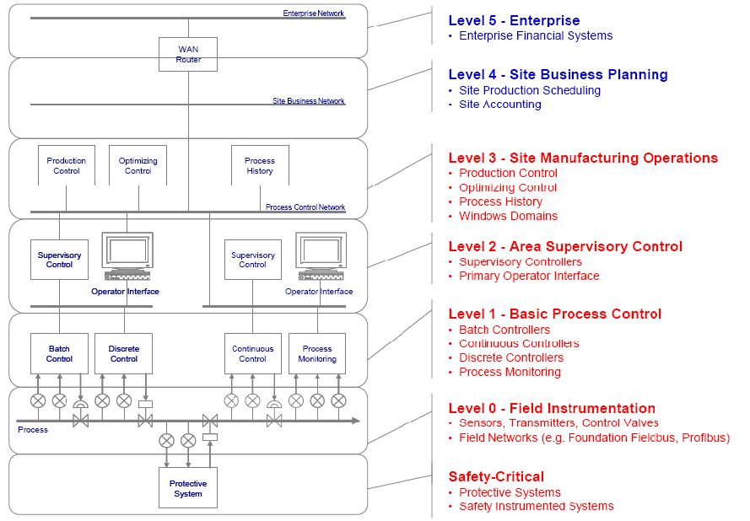
New topic-Security Analysis
Station based Equipment
Control Center
Wayside
Equipment
Data Communication System
Balise
Onboard Equipment

Slide 24
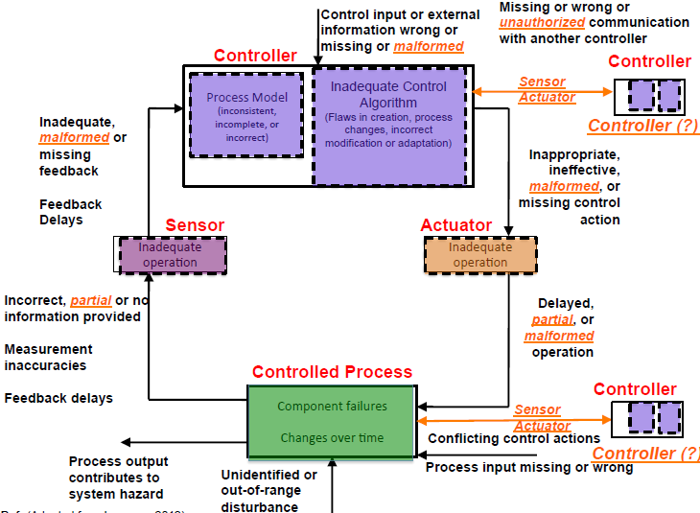
Security Analysis based STAMP (Leveson 2012)

Slide 25
Threat Analysis and Hazard Identification
Site Operation Level -Authorized Access and Deliver Illegal Command
Area Control Level – Intrusion and Deliver Illegal Command
Wayside Level – Fabricating Data
Train – Received Fabricating Data or cannot Communication with Upper Level Controller
Physical interfaces are intruded by Hacker and Viruses are taken into host.

Slide 26
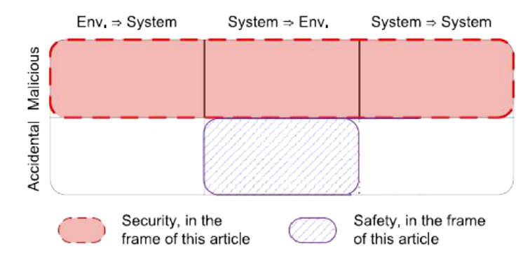
Difference between Safety and Security
Safety – based on the development of technology
  Consequences from system to outside environment
Security- based on the threats and capacity of human
  Should think about protection according to the current situation
  Consequences from system to outside environment, from outside environment to system and from system to system

Slide 27
Conclusion
STPA is more focusing on the safety related interaction and we can easily find the main clue by safety constraints compared to HAZOP;
In order to identify what could cause the unsafe control action or how control actions may not be executed properly, we can use special scenarios to do STPA analysis if we find it is still complex.
In the AUGT operation, more attention should be paid to the Door and PSD control . One hand, passengers should care about the gap between Door and PSD; On the other hand, staff on the platform should watch out for the potential danger. According to the control structure of Page 21, passengers should obey the guidance of the voice alarm or the warning of the staff.

Slide 28
Future Research
Model based Safety Design
Prototype Model based on Systematic Control Structure
Safety Requirements Derived from Safety Constraints and Causal Scenario Analysis
Human – Environment – Computer(Equipment) Interaction Refinement
Model based Safety Test and Assessment
Based on the result of Safety Design
Test Case generated automatically
Software aided quantity Safety Assessment, not just decided by experts and experience

Slide 29
References
IEC 62267-2009 Railway applications: automated urban guided transport(AUGT) :safety requirements[S].IEC,2009.
Leveson N. Engineering a safer world: Systems thinking applied to safety[M]. Mit Press, 2011.
Dong A. Application of CAST and STPA to railroad safety in China[D]. Massachusetts Institute of Technology, 2012.
Leveson N G. A new accident model for engineering safer systems[J].Safety Sci,2004,42(4):237-270.

Slide 30
THANKS !
Email:
Dr. Yan Fei
fyan@bjtu.edu.cn

