Slide 1




Application of STPA on Small Drone Operations:
A Benchmarking Approach
Dr Maria Mikela CHATZIMICHAILIDOUª,
Dr Nektarios KARANIKAS^{b}, Anastasios PLIOUTSIAS^{c}
ªUniversity of Cambridge | Imperial College London, United Kingdom
^{b}Amsterdam University of Applied Sciences, The Netherlands
^{c}National Technical University of Athens, Greece

Slide 2
Outline
Literature review
Current situation
Research framework
Assumptions
Proposed methodology
Results
Final remarks
Mikela CHATZIMICHAILIDOU ESW |September 2016

Slide 3
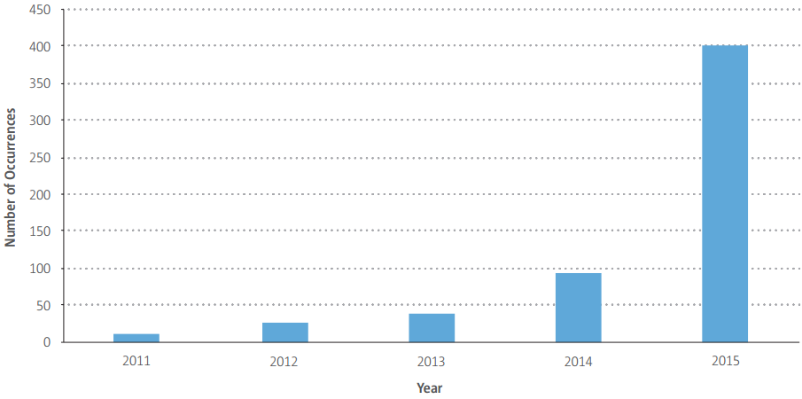
EASA, 2016: Drone Occurrences
400 occurrences in 2015
≈ 4.5 times higher than in 2014
Moreover..
clear & universally accepted Unmanned Aircraft Systems (UAS) regulatory framework not yet in place
UASs currently operated under different regulations depending on the country they are flown
Mikela CHATZIMICHAILIDOU ESW |September 2016

Slide 4
Risk Analysis studies so far..
2015, Clothier et al.: Risk management framework – FMEA, HAZOP
2008, Loh et al.: Suggestions to developers – Safety certification for operation
2011, Dalamagkidis et al.: Reliability assessment – FMEA, FTA; particular models
2015, FAA: Operation and Certification of Small UAS – similar to manned aircraft; airman certification
2002, ACASA: Rules for unmanned aerial activities – pilot qualifications, risk management, airworthiness
2005, Kuchar: Methods for ensuring collision avoidance – FTA, Dynamic Simulation
2013, Lee et al.: Probabilistic safety assessment – collision rates in high-traffic activity
2015, EASA: Technical Opinion – 27 suggestions; low-risk operations irrespectively of take-off mass
2008, Johnson: Contribution of human factors to heavy military UAS loss – Events and Causal Factors accident analysis
Mikela CHATZIMICHAILIDOU ESW |September 2016

Slide 5
Current Situation
No uniform regulatory framework for UASs; especially for light drones
Linear approaches grounded on reductionism; without adequately addressing the complexity of drone flights; no reliable (failure) data
End-user – centric approach:
  publication of directives & regulations focusing heavily on drone operators
  several authorities (e.g., CAA; FAA; ACASA) not addressed requirements for small drone design & certification nor their own responsibilities
Mikela CHATZIMICHAILIDOU ESW |September 2016

Slide 6
Research Framework
STPA-based approach to identify hazards & safety requirements (SRs) for small-drone operations
Analysis of a typical operator – drone system with STPA: list of hazards & causal factors to unwanted events
STPA SRs assigned to authority, manufacturer, operator & automation
4 highly marketed models compared against STPA SRs [Case A]
4 models compared to each other [Case B]
RiskSOAP* methodology: a means of quantification with the Rogers-Tanimoto dissimilarity measure
* Chatzimichailidou, M. M., & Dokas, I. M. (2015). Introducing RiskSOAP to communicate the distributed situation awareness of a system about safety issues: an application to a robotic system. Ergonomics, 1-14.
Mikela CHATZIMICHAILIDOU ESW |September 2016

Slide 7
Assumptions
<25Kg in US & <30Kg in EU
Drone system components: remote controller, drone & display (telemetry)
Rotary aircraft = not subject to aerodynamic limitations
Mission losses in terms of safety
Collisions with fauna not considered
Depth of analysis: end-user – drone; higher hierarchical levels implications
  further decomposition (e.g., architecture and links of software and hardware subsystems) out of scope
Mikela CHATZIMICHAILIDOU ESW |September 2016

Slide 8
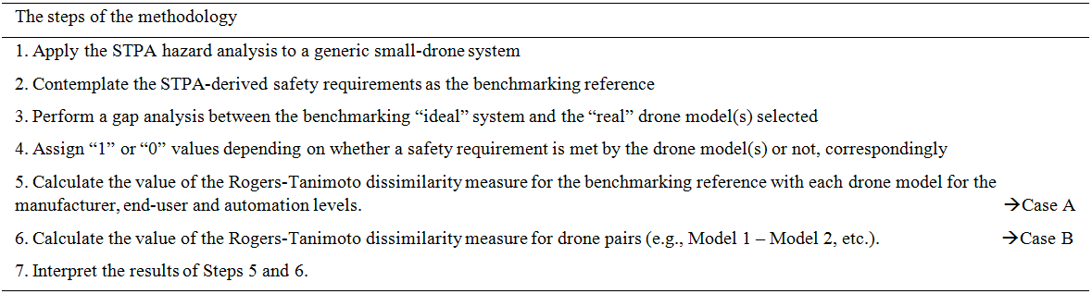
Proposed Methodology [4 Stages-7 Steps]
[Stage 1] Define STPA benchmarking system for small-drone flights
[Stage 2] Map original elements (i.e., SRs met by each drone) to benchmarking system
[Stage 3] Employ a dis.measure for binary data to depict the distance between “ideal” & “real” system
[Stage 4] Use a dis.measure to calculate the differences amongst drones pairwise
Mikela CHATZIMICHAILIDOU ESW |September 2016

Slide 9
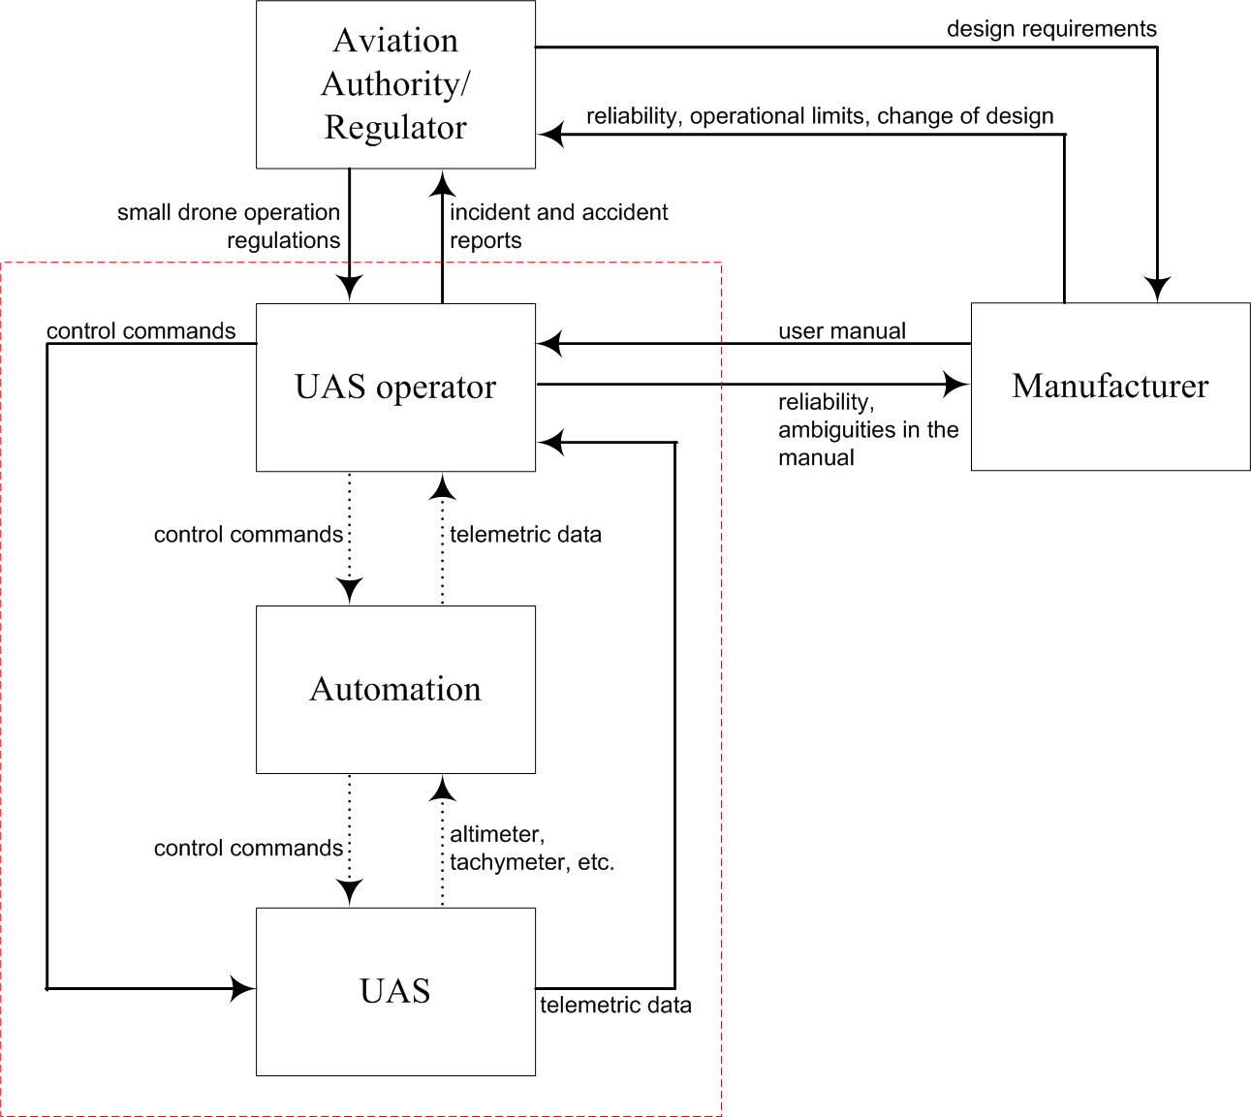
High-level hierarchical control structure
Mikela CHATZIMICHAILIDOU ESW |September 2016

Slide 10
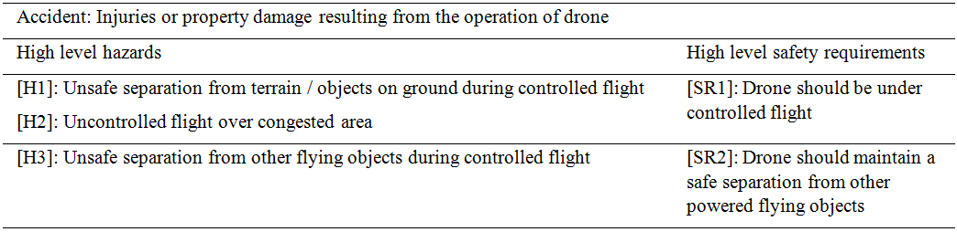
Preliminary STPA Steps
Results
(cont.)
Mikela CHATZIMICHAILIDOU ESW |September 2016

Slide 11
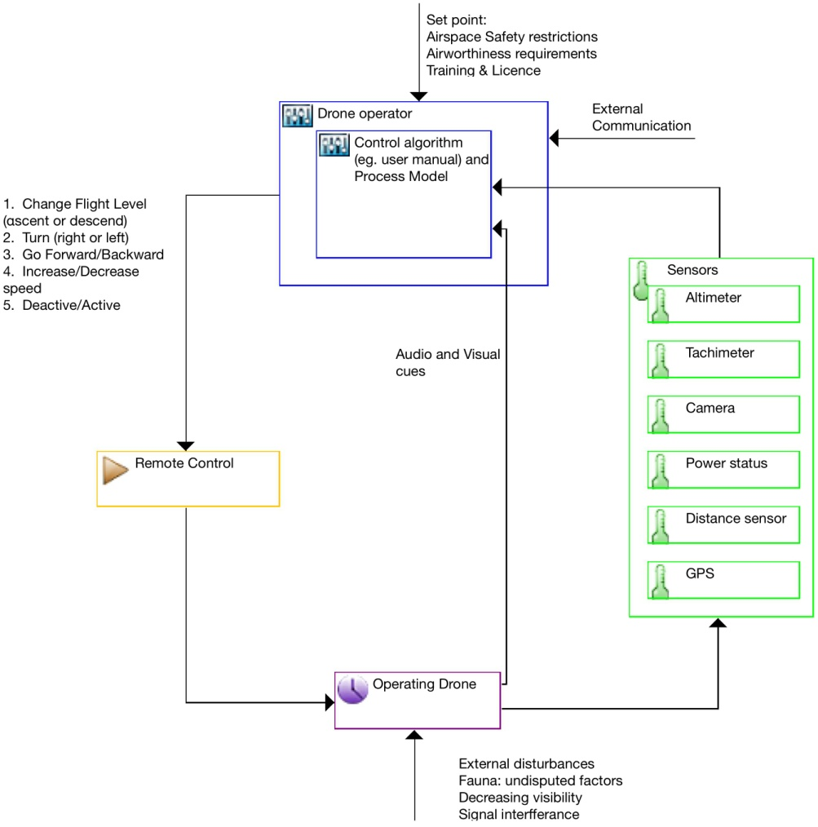
Safety Control Structure
Mikela CHATZIMICHAILIDOU ESW |September 2016

Slide 12
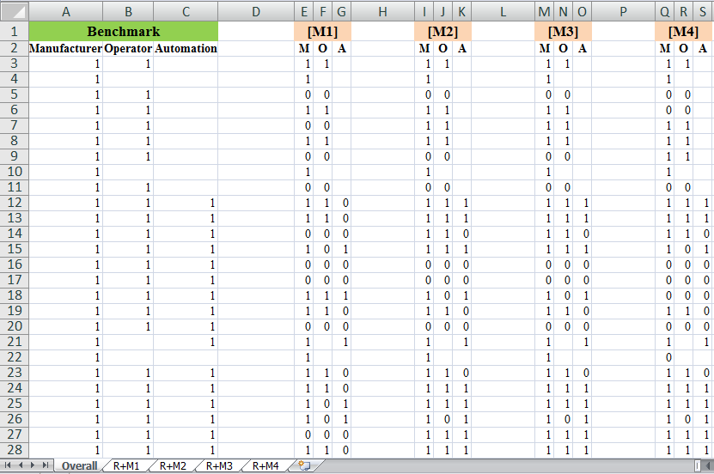

Screenshot of binary data
66 SRs
Mikela CHATZIMICHAILIDOU ESW |September 2016

Slide 13
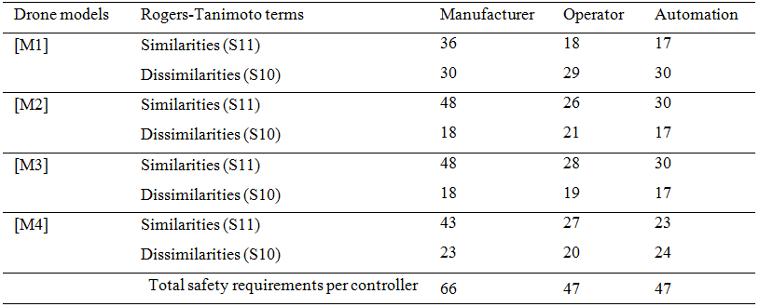
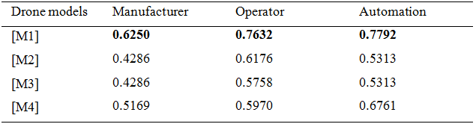
RT[Case A]
Ideal
STPA
M[1]
M[4]
M[2]
M[3]
Mikela CHATZIMICHAILIDOU ESW |September 2016

Slide 14
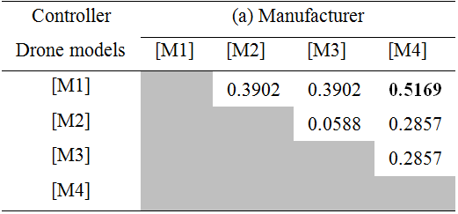
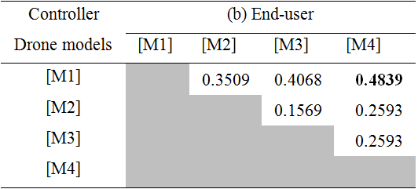
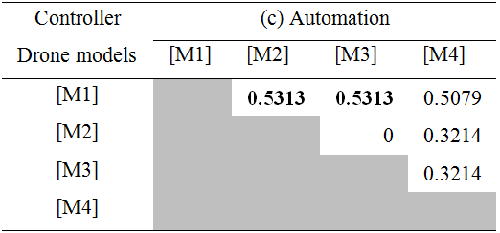
RT[Case B]
M[1]
M[2]
M[3]
M[4]
M[1]
M[2]
M[3]
M[4]
[M2] & [M3] safety controls through automation
[M1] relies on human & meets the least SR
[M2] & [M3] same manufacturer
Mikela CHATZIMICHAILIDOU ESW |September 2016

Slide 15
Summing up (cont.)
Comprehensive analysis to measure dissimilarities
  Case A: benchmark/ STPA – existing/ real drone system
  Case B: exiting/ real done systems, with identified gaps in their SRs (user manuals)
Proposed approach; RiskSOAP adaptation
  Dissimilarity measure other than Rogers-Tanimoto
  4 drone models:
    approach demonstration & safety conclusions with RiskSOAP – Rogers-Tanimoto
    STPA SRs coverage at low to moderate level
    high dissimilarities in meeting the same SRs
Mikela CHATZIMICHAILIDOU ESW |September 2016

Slide 16
Summing up
  STECA (Systems-Theoretic Early Concept Analysis)
    concept analysis: [conceptualisation, system requirements]
    narrative/ textual description of the system under development
  Proposed approach
    later in life-cycle: system already designed & operated; modifications possible
    user manuals & design specifications available; 4 drone models already built
    scs of generic small-drone system drawn after reading several user manuals & regulations explaining how it works
Mikela CHATZIMICHAILIDOU ESW |September 2016

Slide 17
Conclusions (cont.)
  Regulatory framework for small drones diverse & focuses on limitations that the user needs to consider
  Published UAS risk analysis (RA) based on manned aircraft; not on HA for small drones operated in uncontrolled airspaces
  UAS safety research based on statistical analyses & specific accident scenarios or UAS models
    structured HA behind those studies?
  Missing regulatory framework grounded on systematic & transparent safety analysis
Mikela CHATZIMICHAILIDOU ESW |September 2016

Slide 18
Conclusions
  Starting point to move towards the development of a holistic & methodologically justified standardisation scheme for small-drone flights
  Proposed approach
    evaluate “embedded” safety & improve it across existing drone systems over time
    high-level gap analysis between drone specifications & the ideal (i.e., STPA) system [Case A]
    indicate whether drone models offer the same controls over safety constraints [Case B]
Mikela CHATZIMICHAILIDOU ESW |September 2016

Slide 19
Future Work
  RiskSOAP in full: EWaSAP; define sensor characteristics & embed appropriate sensors to enhance threats & vulnerabilities awareness
  Improvements in sensor technology
    no increase in weight, no overwhelming feedback to end-user, no confusion in prioritising safety controls
  19-drone sample (sub. Risk Analysis)
    broader results from comparative analysis
    common & holistic risk management framework for small drones
  Dissimilarity analysis for Authority regulations (sub. ICSC2016)
    extent of diversity of current rules & standards
Mikela CHATZIMICHAILIDOU ESW |September 2016

Slide 20
Acknowledgements
  The authors would like to thank Dr Ioannis Dokas for his idea to apply an adaptation of RiskSOAP in order to indicate the differences amongst the compared drone models in a quantitative manner.
  The authors are also grateful to the two peer-reviewers for their valuable comments and suggestions that helped strengthen the logic of the manuscript.
Mikela CHATZIMICHAILIDOU ESW |September 2016

Slide 21
Thank you!
Contact:
mmc60@cam.ac.uk
mikelachatzimichailidou@gmail.com
ResearchGate, LinkedIn, Twitter, FB

