Slide 1



Safety of automated vehicle trials: an STPA application
Stephanie Alvarez, Yves Page & Franck Guarnieri
4th European STAMP Workshop

Slide 2
INTRODUCTION
During the development of vehicle systems, automakers need to validate aspects such as:
  Technical readiness
  Technical reliability
  Safety
  Acceptability & usage
  Social impacts
  etc.
Validations are carried out via several means like simulation, component testing and vehicle trials on roads.
New challenge: automated vehicle trials (experiments and demonstrations)

Slide 3



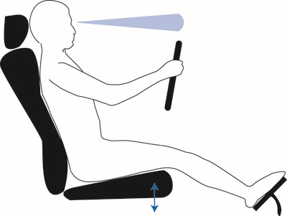
INTRODUCTION
Technical challenges
Human Factor Issues
AUTOMATED DRIVING SYSTEM
MONITORS DRIVING ENVIRONMENT
HUMAN DRIVER
MONITORS DRIVING ENVIRONMENT
Interaction with traffic
0
1
2
3
4
5
No Automation
Driver Assistance
Partial Automation
Conditional Automation
High Automation
Full Automation
Classification of the levels of vehicle automation according to the (SAE 2014)

Slide 4
INTRODUCTION
Automakers need to ensure the safety of all vehicle trials (including the ones involving automated vehicles).
Objective: to establish a “generic” framework for the safety of vehicle trials and to apply it to a demonstration of a highway pilot system (SAE 3).

Slide 5
METHODS
A. “Generic” Framework for the safety of vehicle trials:
B. Applying the “Generic” framework on a highway pilot demonstration:
Data: Company procedures for vehicle trials and semi-structured interviews
Data: Meetings, design reviews, conversations with the demo team.
STPA analysis on the vehicle trial process at the company
Apply the generic framework
Organize the outputs of the STPA analysis into a framework
STPA on the demonstration operation process to consider AV specificities

Slide 6
GENERIC FRAMEWORK
A. “Generic” Framework for the safety of vehicle trials:
Data: Company procedures for vehicle trials and semi-structured interviews
STPA analysis on the vehicle trial process at the company
Organize the outputs of the STPA analysis into a framework

Slide 7
SYSTEM ACCIDENTS, HAZARDS AND CONSTRAINTS
A-1: | People die or get injured from road crashes during a vehicle trial.
A-2: | Property damage from road crashes during a vehicle trial.
H-1: | Vehicle (driven by human, automation or in cooperation) violates minimum safety distance to objects, road users, other vehicles, etc. during a vehicle trial.
H-2: | Vehicle (driven by human, automation or in cooperation) leaves the roadway during a vehicle trial.
SC-1: | Vehicles (driven by human, automation or in cooperation) must not violate minimum safety distance to objects, road users, other vehicles, etc. during a vehicle trial.
SC-2: | Vehicles (driven by human, automation or in cooperation) must not leave the roadway during a vehicle trial.

Slide 8
STPA ON A VEHICLE TRIAL PROCESS:
Congress and Legislatures
Government Agencies, Committees, associations, etc.
Funding Agencies, European Commission, etc.
Other company
STPA outputs | #
Unsafe Control Actions | 55
Scenarios | 80
Safety Requirements | 128
Company Management
Trial Manager
Company Departments and Experts
Trial Executor
Teams
Service Provider
Service Provider
Trial operation process
Experimenter
Human Driver
Infrastructure
Automated Controller
External factors
Actuators
Sensors
Vehicle

Slide 9
GENERIC FRAMEWORK
A. “Generic” Framework for the safety of vehicle trials:
Data: Company procedures for vehicle trials and semi-structured interviews
STPA analysis on the vehicle trial process at the company
Organize the outputs of the STPA analysis into a framework

Slide 10
STRUCTURE OF THE GENERIC FRAMEWORK
I. Vehicle trial compliance
Administration procedures
Insurance policy
Ethical framework
Company standards
Legal framework
Safety Requirements
(128)
II. Vehicle trial safety
a) Trial objectives and conditions
b) Trial preparation
c) Trial operation (vehicle, trial site, driver, etc.)

Slide 11
EXAMPLE FOR TRIAL COMPLIANCE
UCA | Scenario | Safety requirement
The trial manager gets an inadequate insurance policy for the vehicle trial | [Missing feedback] The trial manager gest an inadequate insurance policy for the vehicle trial because the trial manager does not get feedback from the company management on the conditions and procedures for insurance policies | The trial manager must get feedback from the company management on the conditions and procedures for insurance policies
 | [Inadequate mental model] The trial manager gest an inadequate insurance policy for the vehicle trial because the trial manager does not have the knowledge to evaluate the coverage and applicability of the insurance policy for non-standard trials | The trial manager must contact the insurance department and request the evaluation of the insurance policy’s coverage ad application for non-standard trials

Slide 12
EXAMPLES FOR TRIAL SAFETY
UCA | Scenario | Safety requirement
The trial manager establishes general trial conditions that are unsafe | [Inadequate mental model] The trial manager establishes general trial conditions that are unsafe because he/she is not aware of the trial hazards thus he/she does not realize that trial conditions are unsafe | The mental model of the trial manager must include trial hazards
The driver puts the vehicle in an unsafe situation during the driving phase | [Inadequate mental model] The driver puts the vehicle in an unsafe situation because he/she does not understand the vehicle system that is being tested or does not have the required knowledge to operate it | The mental model of the driver must include the information/knowledge necessary to understand and operate the system

Slide 13
APPLYING THE GENERIC FRAMEWORK
A. “Generic” Framework for the safety of vehicle trials:
B. Applying the “Generic” framework on a highway pilot demonstration:
Data: Company procedures for vehicle trials and semi-structured interviews
Data: Meetings, design reviews, conversations with the demo team.
STPA analysis on the vehicle trial process at the company
Apply the generic framework
Organize the outputs of the STPA analysis into a framework
STPA on the demonstration operation process to consider AV specificities

Slide 14
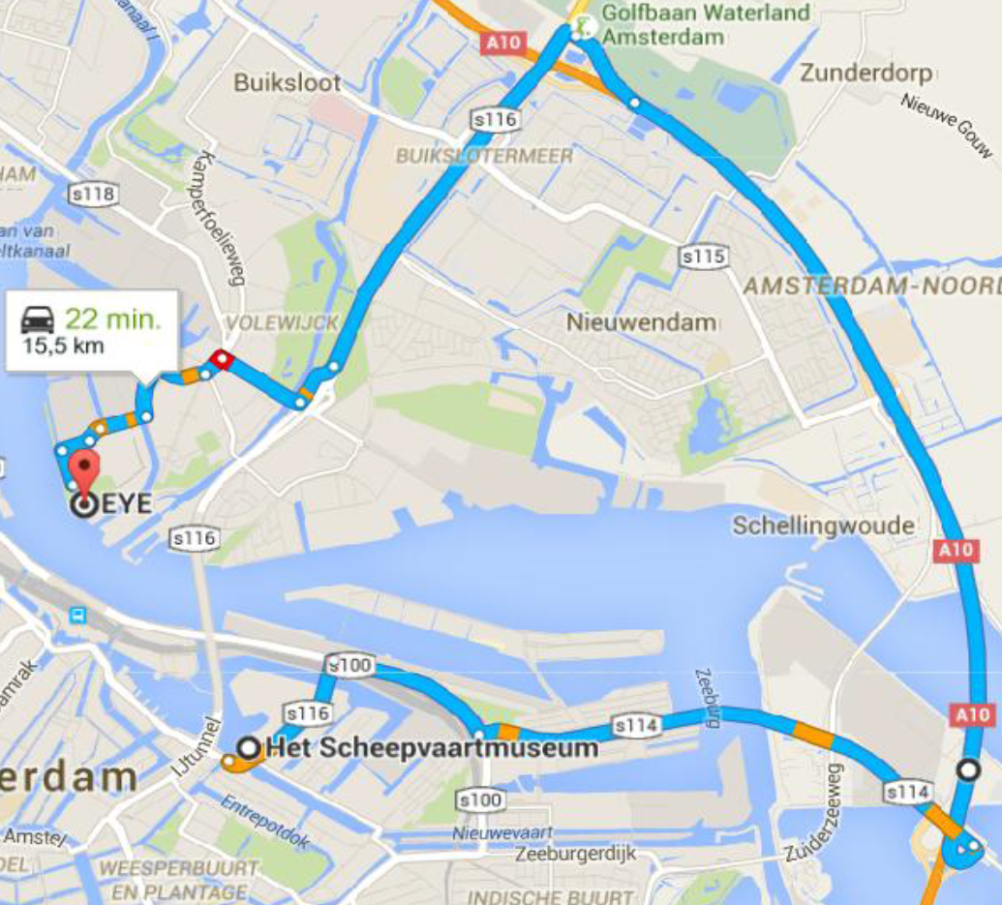
HIGHWAY PILOT DEMONSTRATION
Several automakers participated in the demonstration event
Showcase AV to the EU Minsters of Transport (passengers of the demo)
The Highway Pilot prototype was a hands off, feet off and eyes off system
Demonstration on urban and highway roads
Happy ending: No accidents & declaration of Amsterdam signed!

Slide 15
APPLYING THE GENERIC FRAMEWORK
A. “Generic” Framework for the safety of vehicle trials:
B. Applying the “Generic” framework on a highway pilot demonstration:
Data: Company procedures for vehicle trials and semi-structured interviews
Data: Meetings, design reviews, conversations with the demo team.
STPA analysis on the vehicle trial process at the company
Apply the generic framework
Organize the outputs of the STPA analysis into a framework
STPA on the demonstration operation process to consider AV specificities

Slide 16
APPLYING THE GENERIC FRAMEWORK
I. Vehicle trial compliance
OK (after some updates)
Administration procedures
Insurance policy
Ethical framework
Company standards
Legal framework
II. Vehicle trial safety
a) Trial objectives and conditions
Not specific to Automated Vehicles
b) Trial preparation
c) Trial operation (vehicle, trial site, driver, etc.)

Slide 17
SPECIFICITIES OF AUTOMATED VEHICLES
UCA
The driver puts the vehicle in an unsafe situation during the driving phase
The vehicle has an inadequate response to the driver's inputs during the driving-phase of the vehicle trial.
Automation can put the vehicle in an unsafe situation
Automation can drive the vehicle w/o the driver’s inputs on actuators
We needed to:
  Take into account the specificities of vehicle automation
  Understand how vehicle automation interacts with the whole process (other controllers and phases of the trial)

Slide 18
APPLYING THE GENERIC FRAMEWORK
A. “Generic” Framework for the safety of vehicle trials:
B. Applying the “Generic” framework on a highway pilot demonstration:
Data: Company procedures for vehicle trials and semi-structured interviews
Data: Meetings, design reviews, conversations with the demo team.
STPA analysis on the vehicle trial process at the company
Apply the generic framework
Organize the outputs of the STPA analysis into a framework
STPA on the demonstration operation process to consider AV specificities

Slide 19
SYSTEM ACCIDENTS, HAZARDS AND CONSTRAINTS
A-1: | People die or get injured from road crashes during a vehicle trial.
A-2: | Property damage from road crashes during a vehicle trial.
A-3: | The prototypes (or parts) get stolen or tampered.
H-3: | Non-authorized people have access to the prototypes.
SC-3: | Non-authorized people must not have access to the prototypes.

Slide 20
STPA ON A HIGHWAY PILOT DEMONSTRATION
Dutch Ministry of infrastructure and the environment
RDW
Amsterdam city
Controller | Control Action
Human Driver | Activate AD mode
 | Activate Emergency Stop
 | Takeover control of the vehicle
Automation | Provide control of the vehicle
 | Handover control of the vehicle
Renault (project leader and technical team)
Other participants
Service provider
Demonstration operation process
Safety monitor
Emergency stop
Human Driver
Infrastructure
Examples of control actions specific to automated vehicles
Automated Controller
Actuators
Sensors
Vehicle
Ministers
External factors

Slide 21
ADDITIONAL SAFETY REQUIREMENTS
UCA | Scenario | Safety requirement
The driver activates AD mode when AD mode conditions are not met | [Inadequate mental model] The driver activates AD mode when conditions for AD mode are not met because he/she is unaware that conditions are not met due to a lack of system knowledge and understanding | The mental model of the driver must include adequate system knowledge and understanding which help him/her to determine if conditions are met
Automation provides control of the vehicle and puts the vehicle in an unsafe situation (i.e. leaves the roadway) when AD mode is activated | [Measurement inaccuracies] The vehicle leaves the roadway when AD mode is activated because a portion of the highway has degraded road markings and thus the camera provides inaccurate measurements to the automated controller which result in the vehicle to leaving the roadway | The vehicle driven on manual mode must drive the demonstration route and verify sensor’s performance and infrastructure conditions before the event

Slide 22
CONCLUSIONS
STPA worked on the Generic Framework for vehicle trial safety and the demonstration of a Highway Pilot System (automated vehicle).
STPA approach vs company (existing) procedures:
  A control structure gives a better understanding of the system
  Extend the scope of analysis (human and organizational factors)
  Captures more causes of accidents
  Universal tool (many applications)
The STPA analyses took time and efforts but we see it as an investment.
It helped creating an expertise and an interest in STAMP.
We know the “what” (Safety Requirements) but not the “how”…

